Slide 1
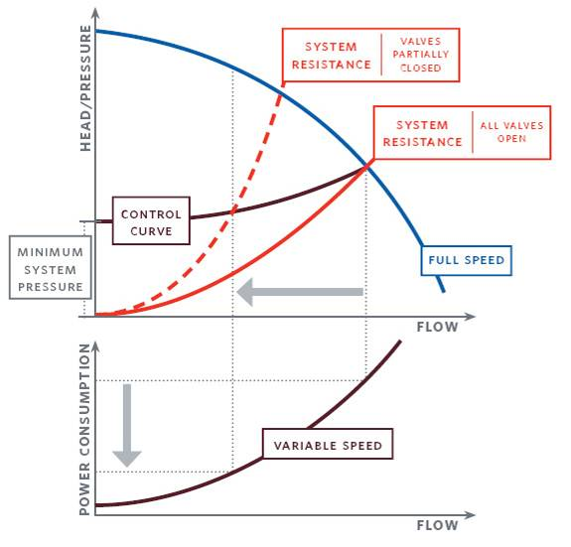
Pump Selection: Meeting and Exceeding ASHRAE Standard 90.1
ASHRAE Ottawa Valley Chapter Meeting 6 - March 18th, 2014
Presenter: Andrew Moore – Armstrong Fluid Technology Technical Support Engineer
Notes:
1

Slide 2
ASHRAE 90.1 Standards for Energy Efficient Buildings Two Main Points
Systems shall have control valves capable of reducing system flow to 50% or less of the design day flow
Systems shall have controls to reduce pumping energy use by 70% of design flow power at 50% flow

Slide 3
Presentation Objectives
The purpose of this presentation is to articulate how pumps are sized
We also want to discuss various strategies for controlling pumps and their impact on energy demand

Slide 4
ASHRAE 90.1
What do we need to explain?
Constant speed pump selection (Constant Speed / Constant Volume)
Pumping as a part load application (Variable Speed / Part Load)
Pump Control:
Constant Speed, three way valve
Constant Speed, throttling valve
Variable Speed, no DP sensor
Variable Speed, DP sensor
Variable Speed, DP sensor location

Slide 5
Tonight’s Agenda
Constant speed, constant volume pumping
Variable Speed, part load pumping
Pump Affinity Laws
Understanding the pump curve
Control with a three valve
Control with a two way valve
Control with a differential pressure sensor and drive
Pump selection (left of the curve, right of the curve)
Part load efficiency
Understanding the system curve
Understanding the control curve
DP valve location and how it effects efficiency

Slide 6
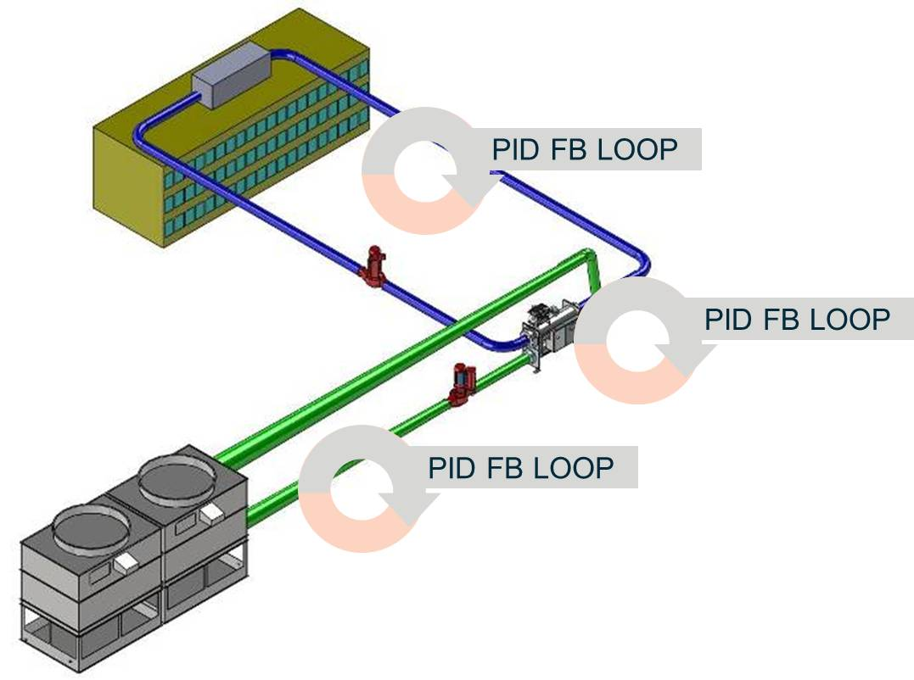
Heat Transfer Equation (Solving the System)
Load (BTU) = Flow (Q) x 500 x (Δ T)

Slide 7
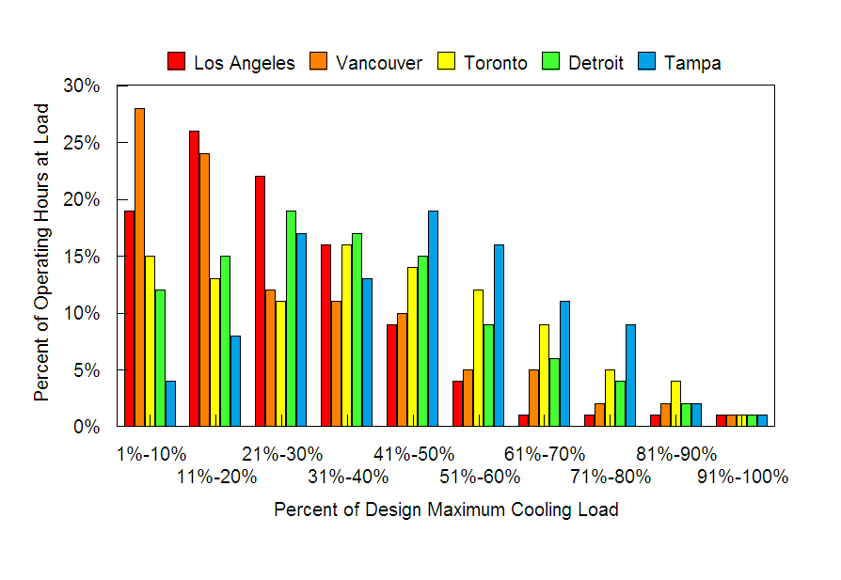
If Comfort Cooling is a Part Load Application, why shouldn’t the sizing of the pump follow the same concept?
Based on our industry being a part-load application
Notes:
This control methodology is predicated on two facts. The first fact is that comfort cooling is a part load application. Regardless of the city or country that a plant designer is addressing, the plant must be sized to accommodate what we refer to as “design day”. This “design day” cooling load occurs maybe for 15 – 30 minutes every year. The majority of the plants operating hours are spent at some fraction of the plants design day capacity.

Slide 8
How do you select a constant speed pump?
Determine flow
Calculate head and add fifteen to twenty percent
Select pump based on design point efficiency
Select non-overloading motor to protect from run out
Select to the left of Best Efficiency point
Impeller is trimmed to this duty point

Slide 9
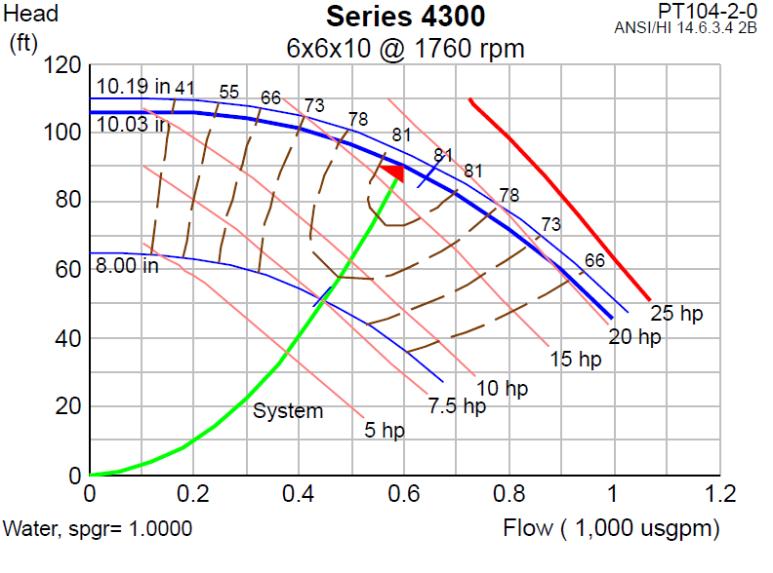
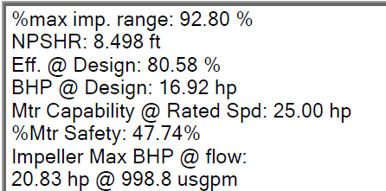
Constant Speed Pump Sizing

Slide 10
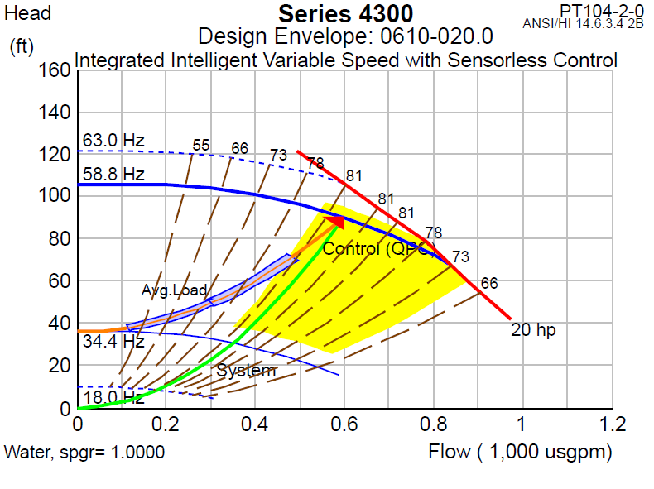
Variable Speed Pumping Sizing

Slide 11
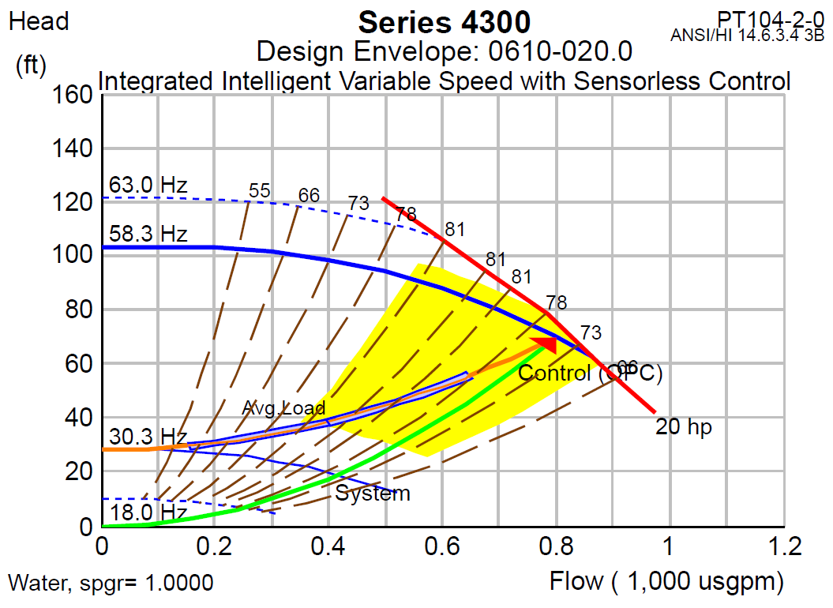
Variable Speed Pumping Sizing

Slide 12
Constant Speed Selection
Constant speed selection is based on flow, head and design point efficiency

Slide 13
Constant Speed Selection
Pump is delivered and installed and is over pumping because in reality there is less head than calculated.
So, what do we do?

Slide 14
Constant Speed Selection
Throttle the pump!
It’s like driving with one foot on the gas and the other on the brake.
Now, if we install a drive, what do we do?

Slide 15
Converting from Constant Speed to Variable Speed
Nothing, because the balancing contractor will use the triple duty valve to throttle the pump and get it back to the stamped nameplate design point.

Slide 16
Converting from Constant Speed to Variable Speed
What we should be doing is using the drive to lock the frequency to the new design point based on actual system head.

Slide 17
Power Consumption
BHP = Flow x Head x S.G.
3960 x Efficiency

Slide 18
Power Consumption Macro

Slide 19
Pump Control Strategies
How do we control a pump?

Slide 20
Pump Affinity Laws
AFFINITY LAWS: influence on volume, pressure and bhp.
For variations in impeller diameter, at constant speed:
D1 = Q1 = H1 BHP1 = D1³
D2 Q2 H2 BHP2 D2³
For variations in speed, with constant impeller diameter:
S1 = Q1 = H1 BHP1 = S1
S2 = Q2 H2 BHP2 S2
Where: D = Impeller Diameter (inch / mm)
H = Pump Head (Ft / m)
Q = Pump Capacity (gpm / lps)
S = Speed (rpm)
BHP = Brake Horsepower (Shaft Power - hp / kW)
√
√
3
√
Notes:
A quick review of the centrifugal pump Affinity laws. As we all know, power is proportional to the speed cubed.
So a 10% change in speed (or flow) results in a 27% less power!
A 50% change in speed (or flow) results in 88% less power.

Slide 21
Pump Affinity Laws – Summarized
Flow varies directly with speed (rpm)*
Pump head varies to the square of speed*
Pump power varies to the cube of speed*
*Or impeller diameter

Slide 22
Pump Control
Pump Control - A History Lesson
Constant Speed, three way valve
Constant Speed, throttling valve
Variable Speed, no DP Sensor
Variable Speed, DP Sensor
Variable Speed, DP Sensor Location
Variable Speed, Sensorless Control

Slide 23
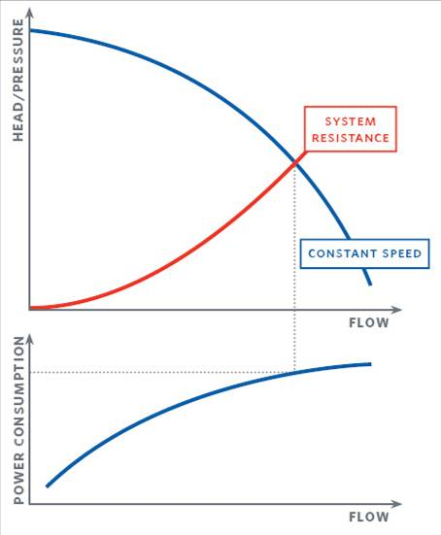
Constant Speed – Three-way Valve

Slide 24
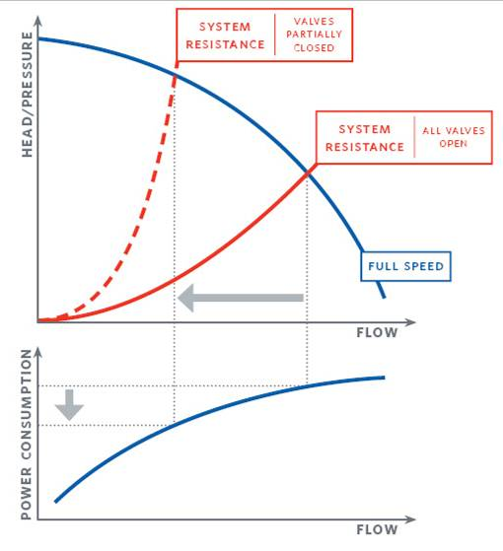
Constant Speed – Two-way Valve

Slide 25
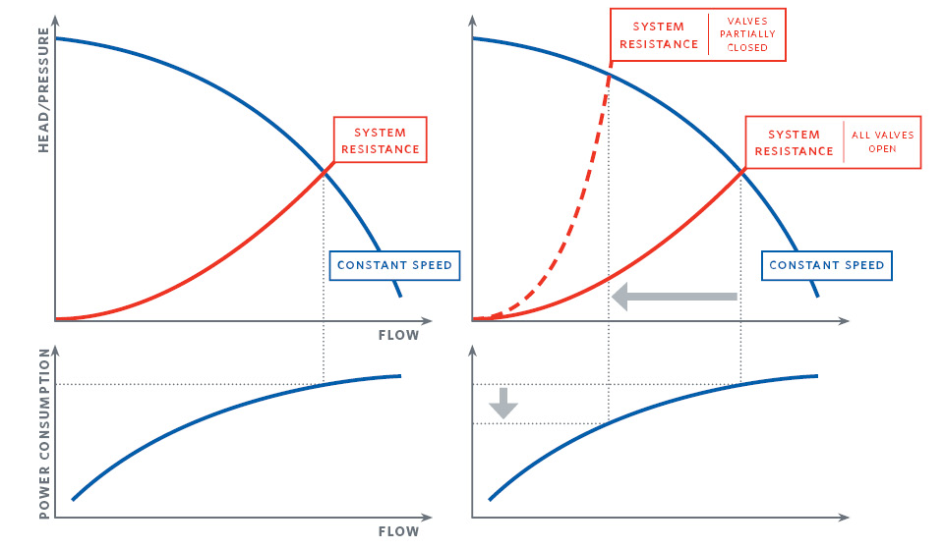
Three-way Valve vs. Two-way Valve

Slide 26
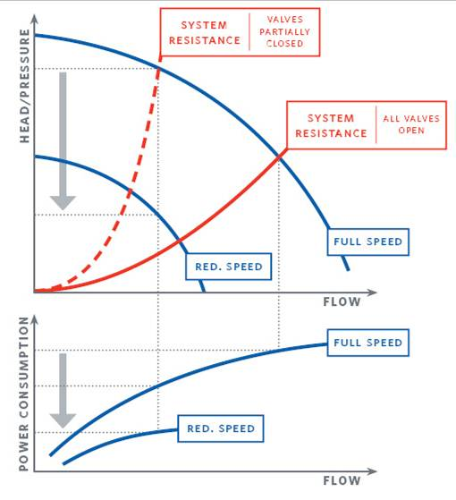
Variable Speed Control with Differential Pressure Sensor

Slide 27
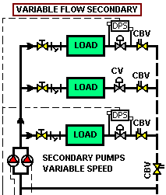
Differential Sensor Location is Critical
Installing the differential pressure sensor across the remote control valve vs. across the supply/return header will increase energy savings by 34% (at 50% flow).
Notes:
27

Slide 28
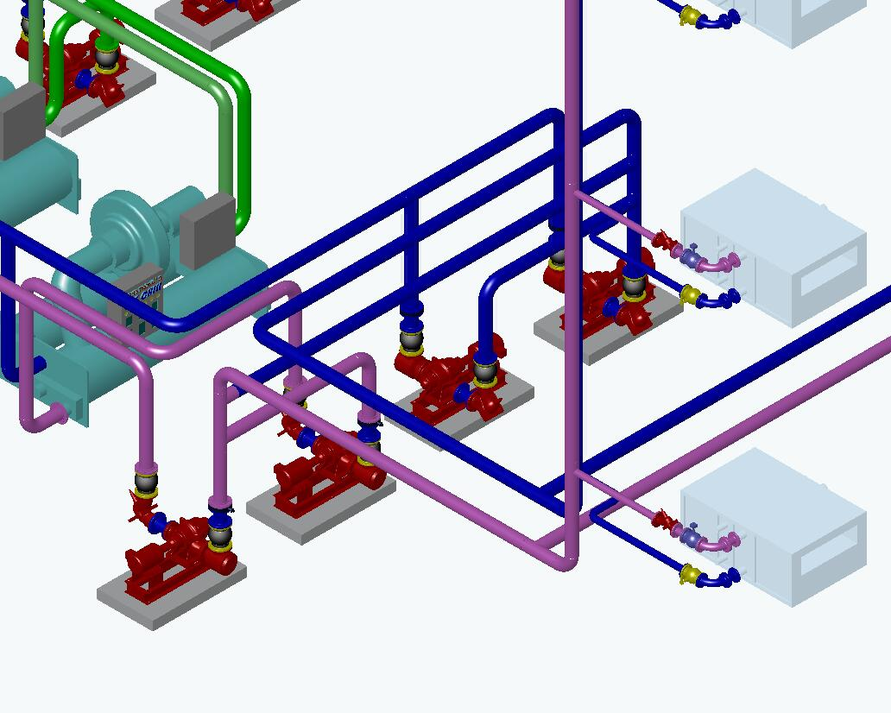
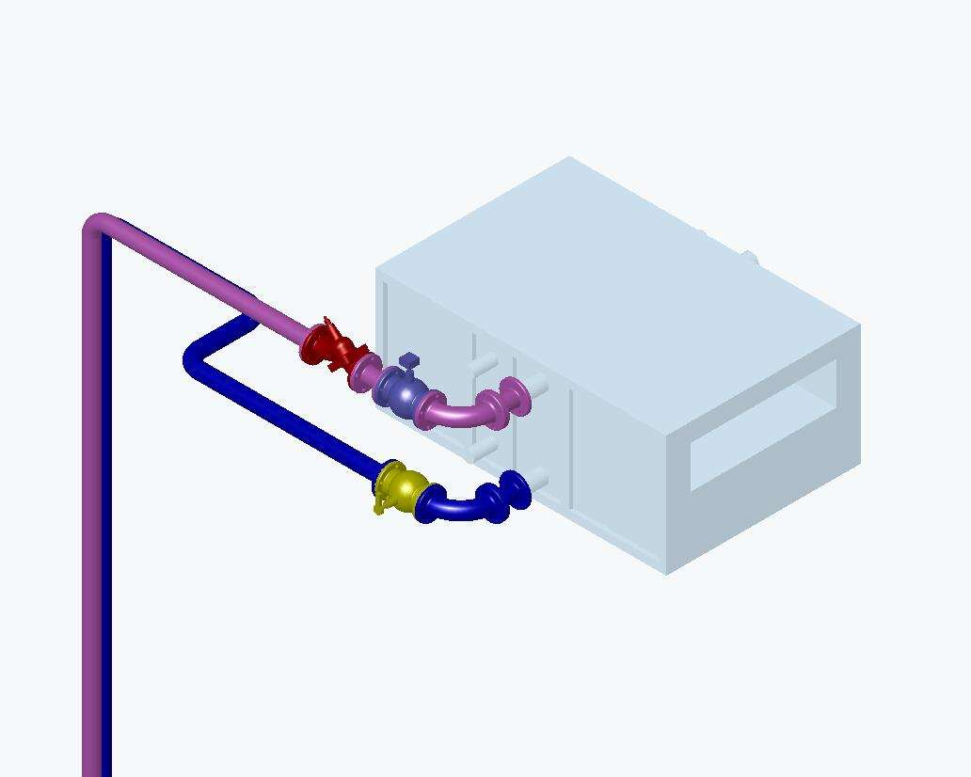
Sensor Placement is Critical
Sensor
VS.
Sensor
Notes:
28

Slide 29
DP Sensor Across Supply/Return Header
Sensor
Notes:
29

Slide 30
Flow @ 50% DP Sensor Across Pump (100 ft)
DP Sensor setting at 100 ft to overcome the entire system head
_{DP: Sensor Setting}
Operating Point: 500 GPM @ 100 FT
Notes:
The reduced speed curve can be plotted on the original pump performance curve. Instead of moving up the constant speed pump curve at reduced flows, to a high pressure, the Pump System Manager (PSM) now can reduce the pump speed to maintain the sensor set point (100 ft in this example) at reduced flow.
The resultant in this case is that the pump speed is reduced to 1599 rpm from the original 1760 rpm.

Slide 31
DP Sensor Across Remote Control Valve
Sensor
Notes:
31

Slide 32
Flow @ 50% - DP Sensor Across Control Valve
DP Sensor setting now at 30 ft vs. 100 ft
DP
_{DP}
Operating Point: 500 GPM @ 48 FT
Notes:
Using our example again we can now superimpose the reduced speed curve for the 50% flow, maintaining the CV design flow DP setting.
In this case we could reduce the pump speed to 1141 rpm and still maintain the system requirements.

Slide 33
Sensorless Control – The Mental Divide
Notes:
DELETE

Slide 34
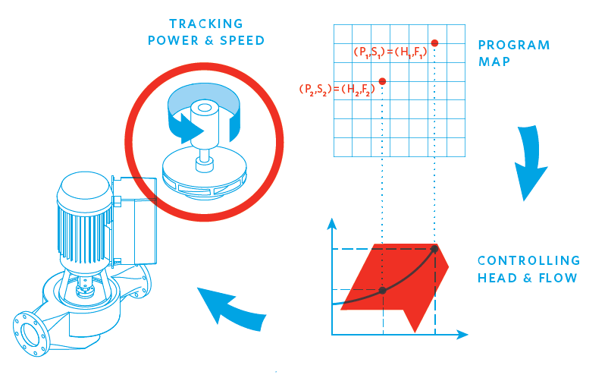
Sensorless Control - Intelligent Variable Speed
Notes:
DELETE

Slide 35
Sensorless Control - Intelligent Variable Speed
Notes:
DELETE

Slide 36
Questions and Answers...

